Slide 1
Data Structures And Algorithms

Slide 2
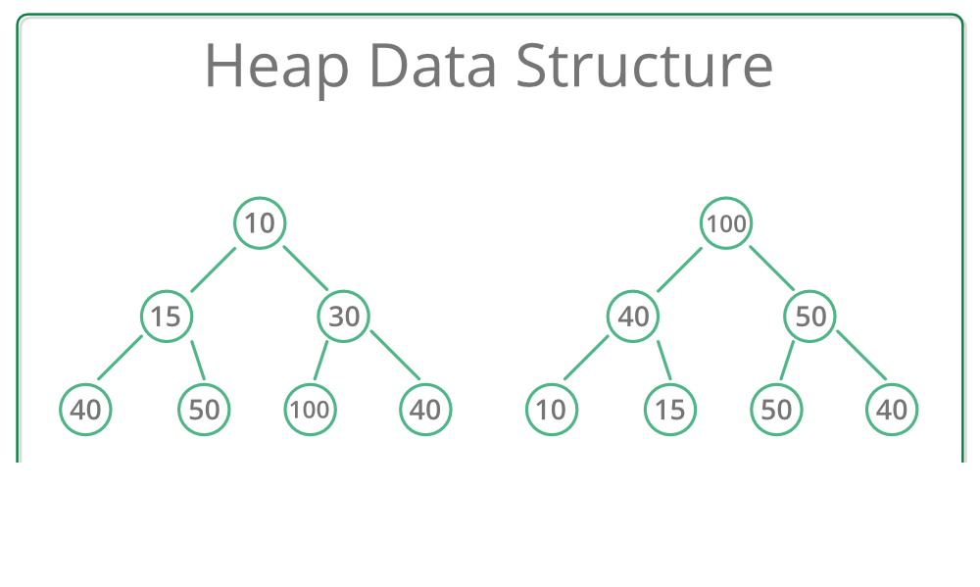
Heap
Heap is a tree based data structure
It follows the following properties:
Structural Property
Ordering Property

Slide 3
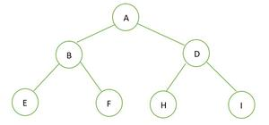
Structural property of heap
Structural property of heap says that the tree must be a complete binary tree.
A complete binary tree is a binary tree in which all the levels of binary tree is completely filled except possibly the last level, which is filled from left side.
All the levels should be filled except for the last one. The last level may or may not be filled.
All the nodes should be filled from left to right.

Slide 4
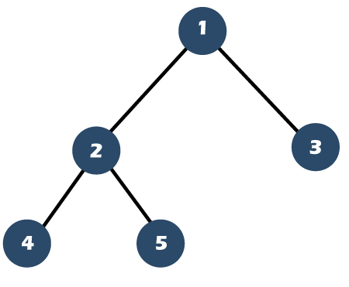
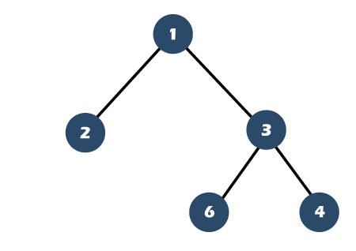
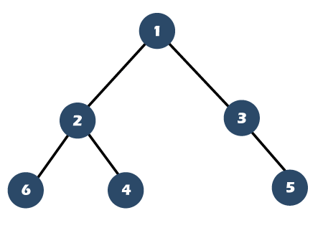
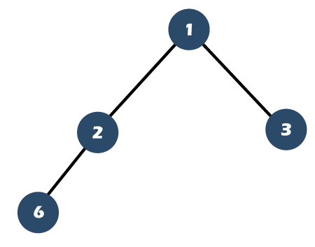
Complete binary tree

Slide 5
Ordering property of heap
Generally, heaps are of two orders/ types.
Min Heap
Max Heap

Slide 6
Array Based implementatiion
Array-based representation of a binary heap, where for a node at index i:
Left child is at 2i + 1
Right child is at 2i + 2
Parent is at (i - 1) / 2 (integer division)

Slide 7
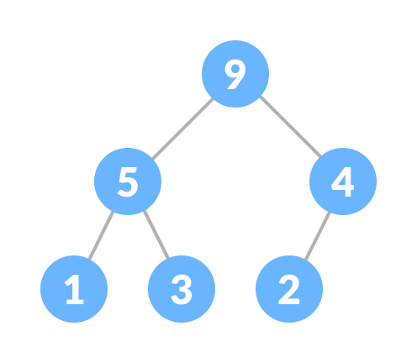
Max heap
In this heap, the value of the root node must be the greatest among all its child nodes and the same thing must be done for its left and right sub-tree also.

Slide 8
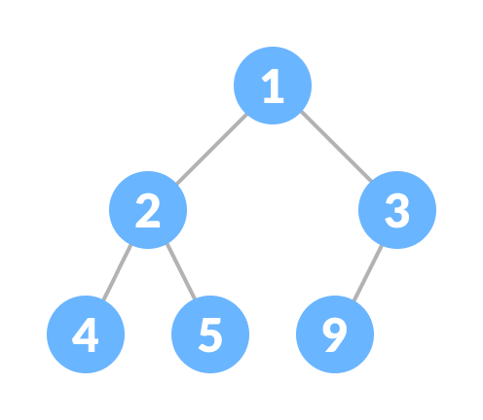
Min heap
In this heap, the value of the root node must be the smallest among all its child nodes and the same thing must be done for its left and right sub-tree also.

Slide 9
Heap tree Construction
There can be two ways to create a heap tree:
1. Insert each key one by one
Time complexity is O(n log n)
2. Heapify Method
Time complexity is O(n)

Slide 10
Heap construction (one by one)
In this method, a heap tree is constructed according to the following points:
Insert the root node
Insert the next key as left child. After insertion compare it with its parent node
If value of parent node is greater than/ less than the value of left child then swap those
Insert the next key as right child. After insertion compare it with its parent node
If value of parent node is greater than/ less than the value of right child then swap those

Slide 11
Heap construction (one by one)
Insert key one by one in empty space takes O(1)
To insert a key into already constructed heap takes O(log n) in worst case
It takes log n comparisons and log n swapping
If there are n elements total then it would be O(n log n)

Slide 12
Heap construction (one by one)
14, 24, 12, 11, 25, 8, 35

Slide 13
Array representation of above Heap
[35, 24, 25, 11, 14, 8, 12]

Slide 14
Heap construction (Heapify)
145, 40, 25, 65, 12, 48, 18, 1, 100, 27, 7, 3, 45, 9, 30
We’ll use bottom-up heapify, starting from the last parent node:
Last parent index = (n - 2) / 2 = (15 - 2)/2 = 6
Apply heapify() from index 6 to 0.

Slide 15
1st step
Heapify at index 6: 18
Children: index 13 (9) and 14 (30)
Max child = 30 → 30 > 18 → swap

Slide 16
2nd step
Heapify at index 5: 48
Children: index 11 (3) and 12 (45)
Max child = 45 → 45 < 48 → no change

Slide 17
3rd step
Heapify at index 4: 12
Children: index 9 (27) and 10 (7)
Max child = 27 → 27 > 12 → swap

Slide 18
4th step
Heapify at index 3: 65
Children: index 7 (1) and 8 (100)
Max child = 100 → 100 > 65 → swap

Slide 19
Final heap
[145, 100, 48, 65, 27, 45, 30, 1, 40, 12, 7, 3, 25, 9, 18]

Slide 20
deletion of an element
Deleting an element in heap tree is not simple
You cannot delete an element directly from heap tree except that it is rightmost leaf element
Since deleting an element at any intermediary position in the heap can be costly, so we can simply replace the element to be deleted by the last element and delete the last element of the Heap
Replace the root or element to be deleted by the last element
Delete the last element from the Heap
Since, the last element is now placed at the position of the root node. So, it may not follow the heap property. Therefore, heapify the last node placed at the position of root
Time complexity is O(log n) where n is no of elements in the heap

Slide 21
Heap sort
Heap sort is a comparison-based sorting technique based on binary heap data structure.
It is similar to the selection sort where we first find the minimum element and place the minimum element at the beginning. Repeat the same process for the remaining elements.
In case of max heap:
One by one delete the root node of the Max-heap and replace it with the last node in the heap and then heapify the root of the heap.
In case of min heap:
One by one delete the root node of the Min-heap and replace it with the first node in the heap and then heapify the root of the heap.
Time Complexity: O(n log n) → O(n) + O(n log n)

Slide 22
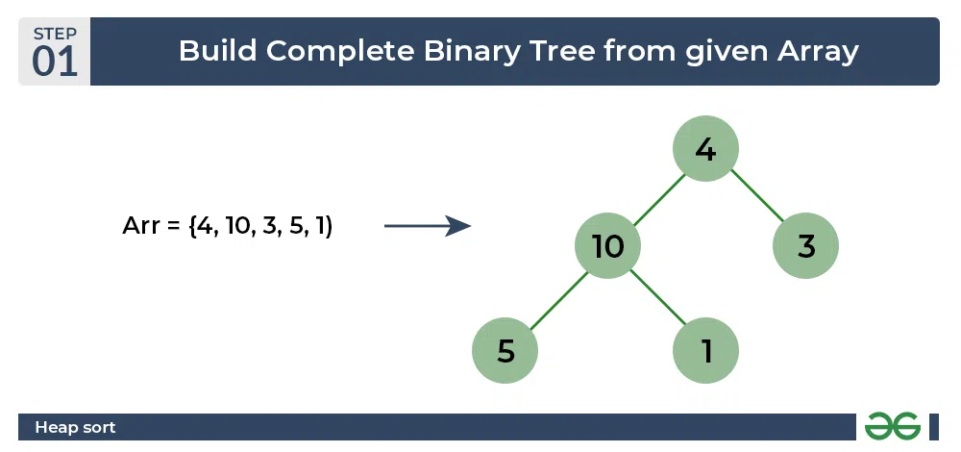
Example: Heap sort

Slide 23
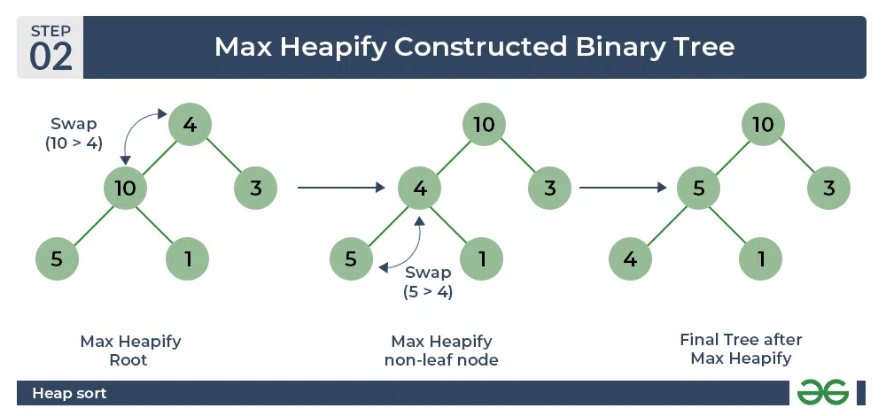
Example: Heap sort

Slide 24
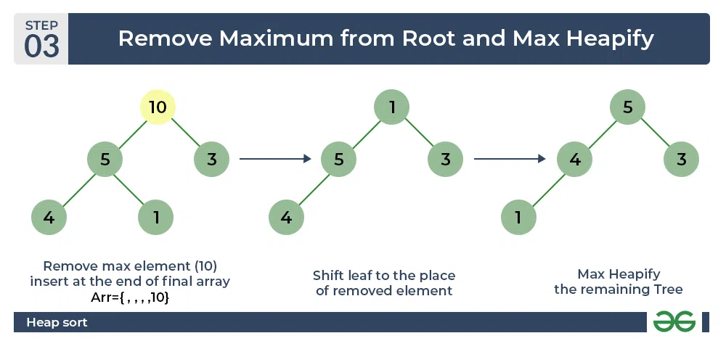
Example: Heap sort

Slide 25
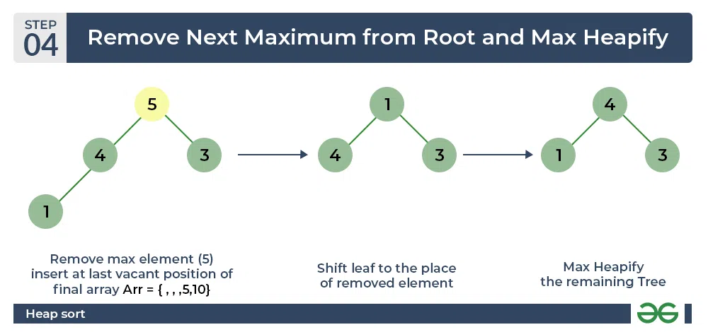
Example: Heap sort

Slide 26
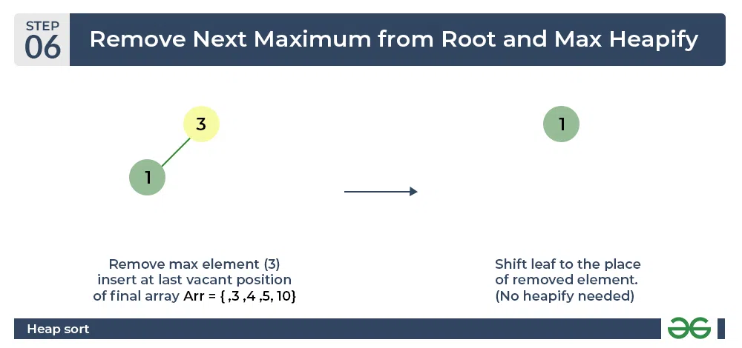
Example: Heap sort

Slide 27
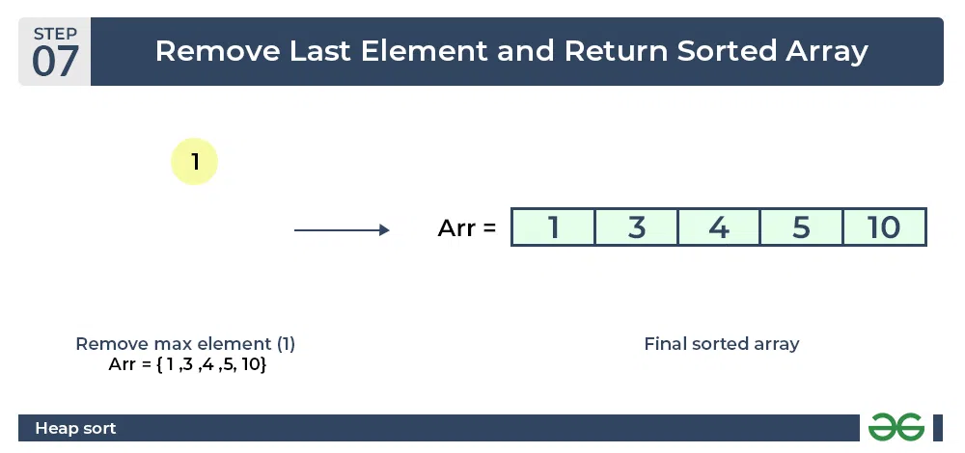
Example: Heap sort

